Slide 1


MEDLM: EXPLORING LANGUAGE MODELS FOR MEDICAL QUESTION ANSWERING SYSTEMS
A PRESENTATION BY: GABRIEL PILA, JAY JHAVERI, NIRAJ YAGNIK, VIVEK SHARMA

Slide 2

CONTENT
01
PROBLEM STATEMENT
02
MOTIVATION
03
RESEARCH QUESTIONS
04
BACKGROUND
05
DATASETS
06
METHODOLOGY
07
RESULTS
08
FUTURE WORK AND CONCLUSION

Slide 3






PROBLEM STATEMENT
1
2
3
4
Healthcare professionals struggle to stay updated with the latest medical literature and make evidence-based decisions due to the overwhelming abundance of information.
Current Methods mainly rely on Information Retrieval techniques and not LLMs for Generation:need Closed Generative QA
The growing need for accurate and automated medical information
The effectiveness of these systems depends on the scale and quality of the underlying language models used to generate answers.

Slide 4






RESEARCH QUESTIONS
Reliability of Generative Language Models for the task of Medical QnA - Setting the benchmark scores for Closed Generative QA
Do Distilled Fine-Tuned LLMs perform better than General LLMS
Do Decoder-only Models perform better than Encoder-Decoder Model
Does Prompt Engineering Enhance the performance of LLMs for the task of for the task of Medical QnA
RQ1
RQ2
RQ3
RQ4

Slide 5


BACKGROUND
QUESTION - ANSWERING
Input
Output
MMR vaccine is a combination vaccine that protects against three separate illnesses: measles, mumps, and rubella. The MMR vaccine is given as a single shot to children, usually between 12 and 15 months of age, before they are exposed to the virus.
What is MMR Vaccine
Question Answering Model

Slide 6
BACKGROUND
QUESTION - ANSWERING
Question Answering Model
Extractive QA
Open Generative QA
Closed Generative QA

Slide 7

BACKGROUND
CLOSED GENERATIVE QA
Pretrained LM
FineTuned LM
Q:
A:
Q:
A:
Q:
A:
Q:
A:
Fine Tuning

Slide 8
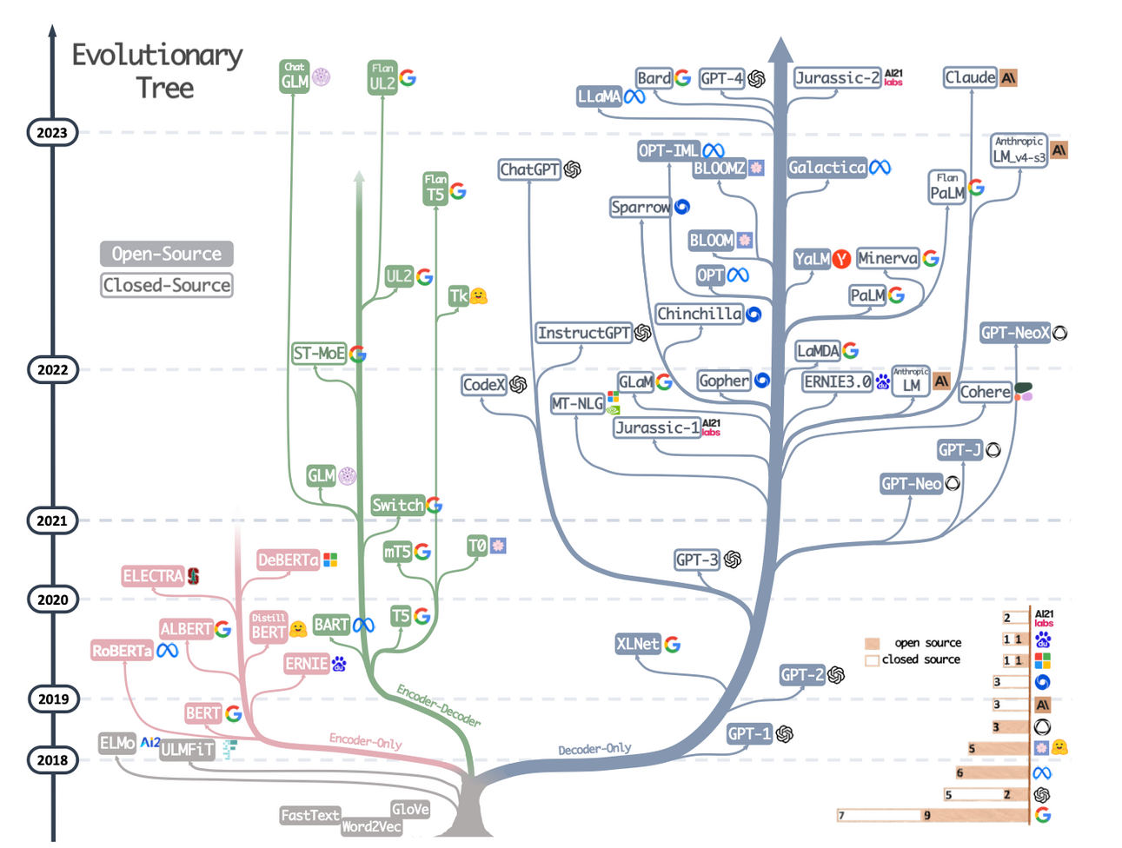
BACKGROUND
LARGE LANGUAGE MODELS

Slide 9
DATASETS
DIVERSITY OF DATASETS AVAILABLE
Medical-related datasets
MedQuAD
MEDIQA-An
iCliniq
TREC LiveQA-Med
Etc
https://github.com/abachaa/Existing-Medical-QA-Datasets
Selection procedure
Dataset Task
Domain of Questions
Trustworthiness (NIH)

Slide 10

DATASETS
MEDQUAD*
Used for Training and Validation
47,457
medical question-answering pairs created from NIH websites
37
question types associated with diseases, drugs and other medical entities
Training set
Validation set
*Curated dataset from NIH (highest-quality)

Slide 11
DATASETS
ICLINIQ*
Used for Validation
27k
medical question-answering pairs
70
topics
*Lower quality than MedQuAD

Slide 12


METHODOLOGY
ADVISED BY:
Dr. Asma Ben Abacha
Senior Scientist at Microsoft Health AI
Ph.D. in Computer Science, Paris-Sud University, France.

Slide 13
METHODOLOGY
TECHNIQUES ADAPTED
Testing on BASE LLM
Prompting Base LLM
(In-Context Learning)
Fine-Tuning on Distilled Models

Slide 14
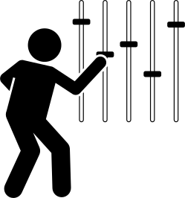


METHODOLOGY
FINE-TUNING OF LLMS
"[Q]: ____"
Distilled Pre-trained LM:
GPT2, BLOOM, T5
FineTuned LM
Q:
A:
Q:
A:
"[Q]: ____[A]:"
"[Q]: ____[A]:"
Q:
A:
Q:
A:
:
"[Q]: ____[A]:"
"[A]: ____"
Preprocess Data:
Truncate Text
Clean Text
Add Markers
Tokenize

Slide 15

METHODOLOGY
FINE-TUNING PROCESS
MedQuAD Training set
INPUT
Question
Answer
Max: 4k tokens
Median: 270 tokens
Truncated at 300 tokens for training
iCliniq Training set
INPUT
Max: 1.7k tokens
Median: 93 tokens
Question
Answer
Truncated at 150 tokens for training

Slide 16
METHODOLOGY
BASE LLM
"[Q]: ____"
BASE LLM
"[A]: ____"

Slide 17
METHODOLOGY
PROMPT ENGINEERING
Techniques
Static Prompting
Dynamic Prompting
Same set of sample QnA for each
entry in the test set
Using Question Embeddings to fetch top-k
most similar question-answers
from the train set

Slide 18
METHODOLOGY
DYNAMIC PROMPTING
Original Question
"[Q]: ____"
Train Set
Getting Embeddings using Instructor Embedding
BASE LLM
Cosine Similarity
Get Top-K
Most
Similar Q-A pairs
Getting Embeddings using Instructor Embedding
"[Q]: ____"
Question
"[A]: ____"

Slide 19
METHODOLOGY
EVALUATION OF LLMS
Base models, fine-tuned models, and prompted queries
Finetuned with:
Evaluated in:
1
Base LLMs
No
MedQuAD
validation set
ICliniq
validation set
2
Prompted LLMs
No
MedQuAD
validation set
ICliniq
validation set
3
Fine-tuned LLMs
MedQuAD training set
iCliniq training set
MedQuAD
validation set
ICliniq
validation set

Slide 20
METHODOLOGY
MODELS EVALUATED
GPT2
GPT3.5
Bloom
T5
1
Base LLMs
2
Prompted LLMs
3
Fine-tuned LLMs

Slide 21


RESULTS
METRICS USED
Automatic Evaluation
Human Evaluation
Real VS Generated answer
Survey to evaluate generated answers
BLEU 1 Gram
ROUGE 1 Gram
Doctors Evaluation
Users Evaluation
BLEU 4 Gram
ROUGE L Gram
*BLEU: Tokens covered/ Total
*ROUGE: Similar to Recall (correct tokens identified)

Slide 22
RESULTS
WORST OUTPUT EXAMPLES
Question: What is (are) Fever ? (Also called: Elevated temperature; Hyperthermia; Pyrexia)
Bloom
Fine-Tuned
Fever is a common condition that occurs when the body's temperature is higher than normal. It is a common disorder that affects many parts of the body, including the head, face, throat, throat, chest, abdomen, and legs. It is also common in children and young adults. Fever is a common disorder that affects many parts of the body, including the head, face, throat, throat, chest, abdomen, and legs. It is also common in children and young adults. It is also common in children and young adults....
GPT2
Fine-Tuned
Acquired temperature (also called: F) contains several tiny viruses and bacteria that cause fever is more than twice as common in women includes all four major illnesses many medicines and some toxic side effects the effects of drugs, so its cause is often unknown can cause serious health problems in a variety of ways is caused by exposure to a lot of fluid, especially from salt water and food contaminated with human and animal products;...
T5
Fine-Tuned
Fever is a rare condition that affects the body\'s ability to regulate temperature. it can be caused by changes (mutations) in certain parts of the body, such as blood vessels or other organs; however, there are many different types of "fever" which may include: hyperthermia/hyperthermia-pyrexia and an abnormally high level of energy called hemorrhagic acidosinophilus -- also known as hypothyroidism).

Slide 23
RESULTS
OUTPUT EXAMPLES
GPT3.5 w/Prompt
A fever is a temporary elevation in body temperature that is usually caused by an infection. Fever is a common response of the body to infection, and is a sign that the body is trying to fight the infection. A fever can be a sign of many different types of infections, including viral, bacterial, fungal, parasitic, and even autoimmune. A fever is often accompanied by chills, fatigue, and weakness. A fever may be a symptom of a serious infection, and should always be evaluated by a doctor. A fever is not a disease, but rather a sign of a problem. A fever is a temporary elevation in body temperature that is usually caused by an infection....
ChatGPT 4
Fever is a condition in which the body's thermoregulatory center in the brain raises the body temperature above normal. It is usually caused by infection. A fever is not a disease in itself. It is a symptom of an underlying condition.

Slide 24
RESULTS
METRICS OBTAINED ON MEDQUAD
Model | Bleu1 | Bleu4 | Rouge-1 | Rouge-L
T5 | 6.186 | 0.239 | 0.199 | 0.178
GPT-2 | 3.806 | 0.132 | 0.196 | 0.181
Bloom | 1.577 | 0.043 | 0.193 | 0.180
GPT-3.5 w/Static Prompt | 3.413 | 0.122 | 0.232 | 0.216
GPT-3.5 w/TypeWise Dynamic Prompt | 7.132 | 0.344 | 0.222 | 0.211
ChatGPT-4 Dynamic Prompting | 3.550 | 0.107 | 0.129 | 0.121

Slide 25
RESULTS
METRICS OBTAINED ON MEDQUAD
Model | Bleu1 | Bleu4 | Rouge-1 | Rouge-L
GPT-3.5 w/TypeWise Dynamic Prompt | 7.132 | 0.344 | 0.222 | 0.211
ChatGPT-3 Dynamic Prompting | 5.5287 | 0.290 | 0.2029 | 0.1897

Slide 26
RESULTS
DATA AUGMENTATION EFFECT
Model | Bleu1 | Bleu4 | Rouge-1 | Rouge-L
T5 | 7.117 | 0.321 | 0.207 | 0.186
GPT-2 | 5.132 | 0.242 | 0.190 | 0.174
Bloom | 1.871 | 0.046 | 0.226 | 0.212

Slide 27
RESULTS
METRICS OBTAINED ON ICLINIQ
Model | Bleu1 | Bleu4 | Rouge-1 | Rouge-L
GPT3.5 w/Static Prompt | 2.434 | 0.097 | 0.221 | 0.199
T5 | 9.843 | 0.807 | 0.173 | 0.145
GPT-2 | 9.989 | 0.855 | 0.139 | 0.123

Slide 28
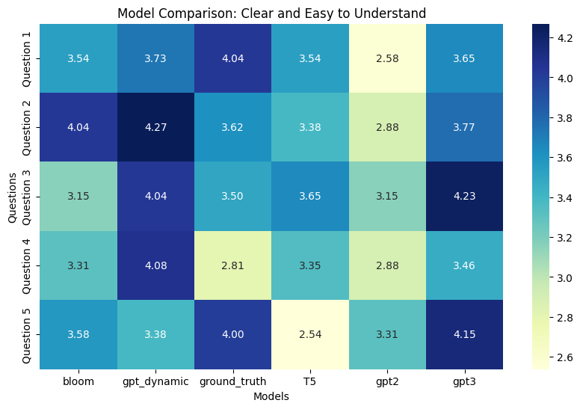
RESULTS
Users
HUMAN EVALUATION

Slide 29
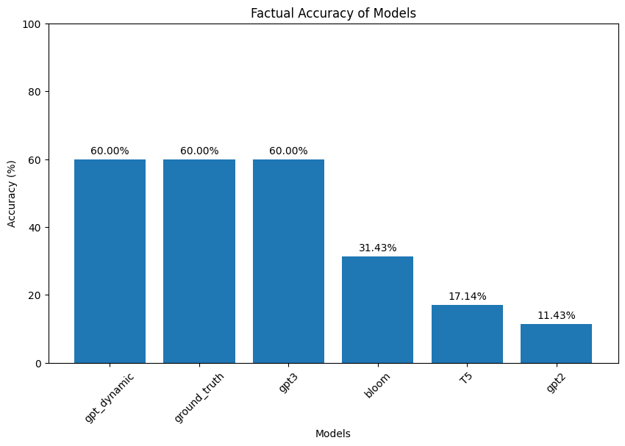
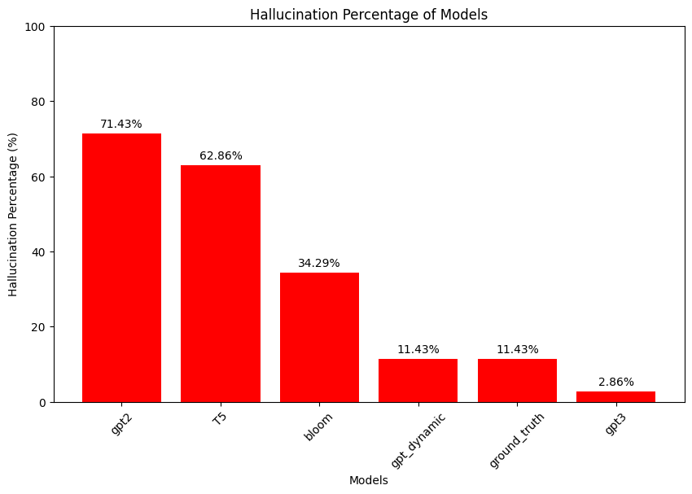
RESULTS
Doctors
HUMAN EVALUATION

Slide 30
FINDINGS/CONTRIBUTIONS
The work lays down a good benchmark for future work on Generative Medical QnA and other domain-specific
Although users found the answers clear and accurate, the models' metric scores were low, highlighting the need for new metrics.
Static Prompt Engineering is still not a stable, reliable and go-to technique for the task of Generative QnA just yet
Decoder-only Models quantatively perform better than Encoder-Decoder Model
FINDING 1
FINDING 2
FINDING 3
FINDING 4

Slide 31


MORE FINDINGS
Dynamic prompting is proving to be better than predefined static programming.
A tradeoff exists between higher-quality data and larger costlier models
Data Augmentation enhances the performance of the models
FINDING 5
FINDING 6
FINDING 7

Slide 32

Limitations
Future Work
1. Hallucination is very much prevalent in the answers
2. Limited datasets with too wordy answers
3. Access to validation from human Experts was hard.
4. Limited access to compute prevented the fine-tuning of the largest models (e.g. GPT4)
1. Test Dynamic Prompting on GPT-4 OpenAI API.
2. Fine-Tuning on GPT3, GPT 4 and other larger versions of models.
3. Coming up with better metrics for Generative QnA tasks.
4. Enhance the dataset through summarization to reduce the length of the answers.

Slide 33

CONCLUSION
01
02
03
04
05
STATE OF GENERATIVE QNA
DATA AUGMENTATION
NEW METRICS
COMPARISONS
PROMPTING
The work experiments with a total of 20 different techniques on 2 datasets to find the most accurate method
The work exposes the sensitivity of prompt engineering as a technique for generative QnA
The works shows that data augmentation can improve model performance.
Raises the need for new metrics
The work lays down a good benchmark for future work on Generative Medical QnA

Slide 34
Thank You!!

